Slide 1
Acknowledgement Internet Images, available in Public Domain, have been used in many Slides of this Presentation. Some of the Images have also been Modified/Superimposed. Used only for Academic Purpose/Understanding.
Lecture-6
Takeaways :
The Transfer Function Concept and a System Theoretic Overview
The Concept of Feedback and Closed Loop Dynamical Systems
Understanding Transient Characteristics of Dynamical Systems
Determining Time Constants of Systems & Equipment, as a Maintenance Management Tool
Understanding System Type (from Transfer Functions) and Steady State Errors
Discretization for Digital Control --- Introduction to the Concept of z-transforms

Slide 2
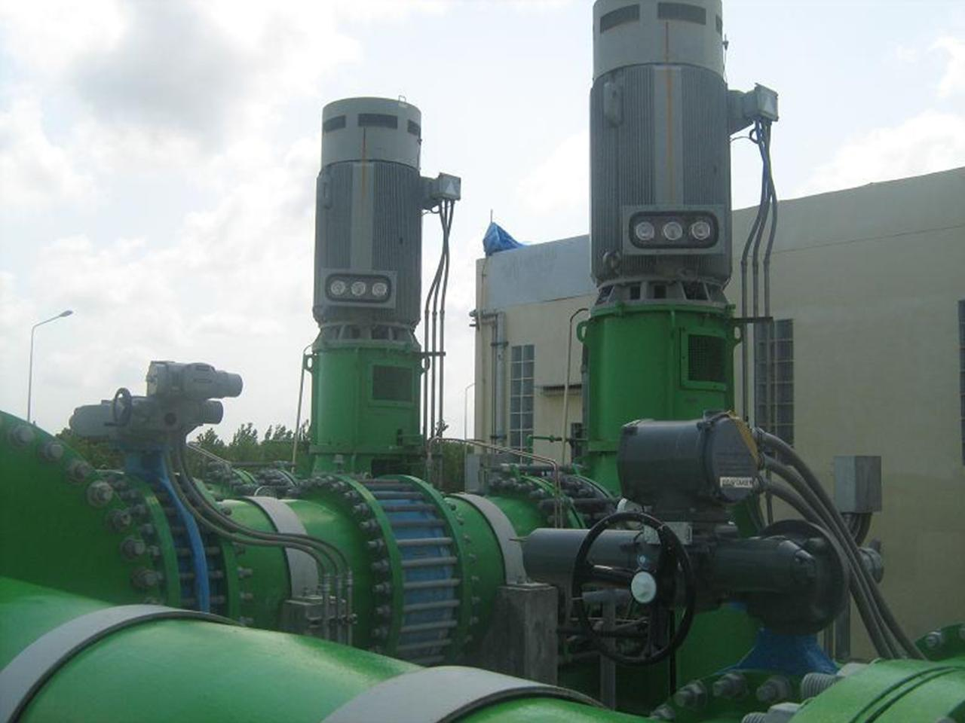
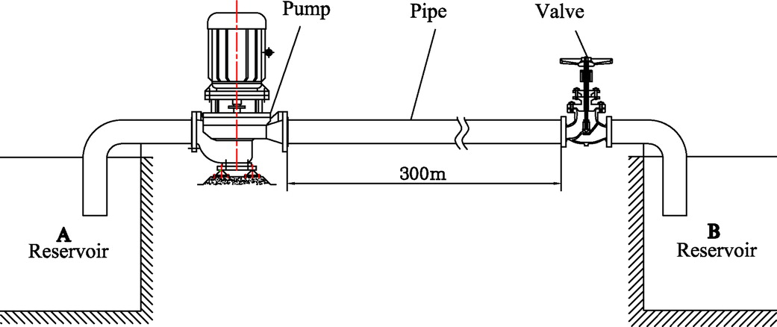
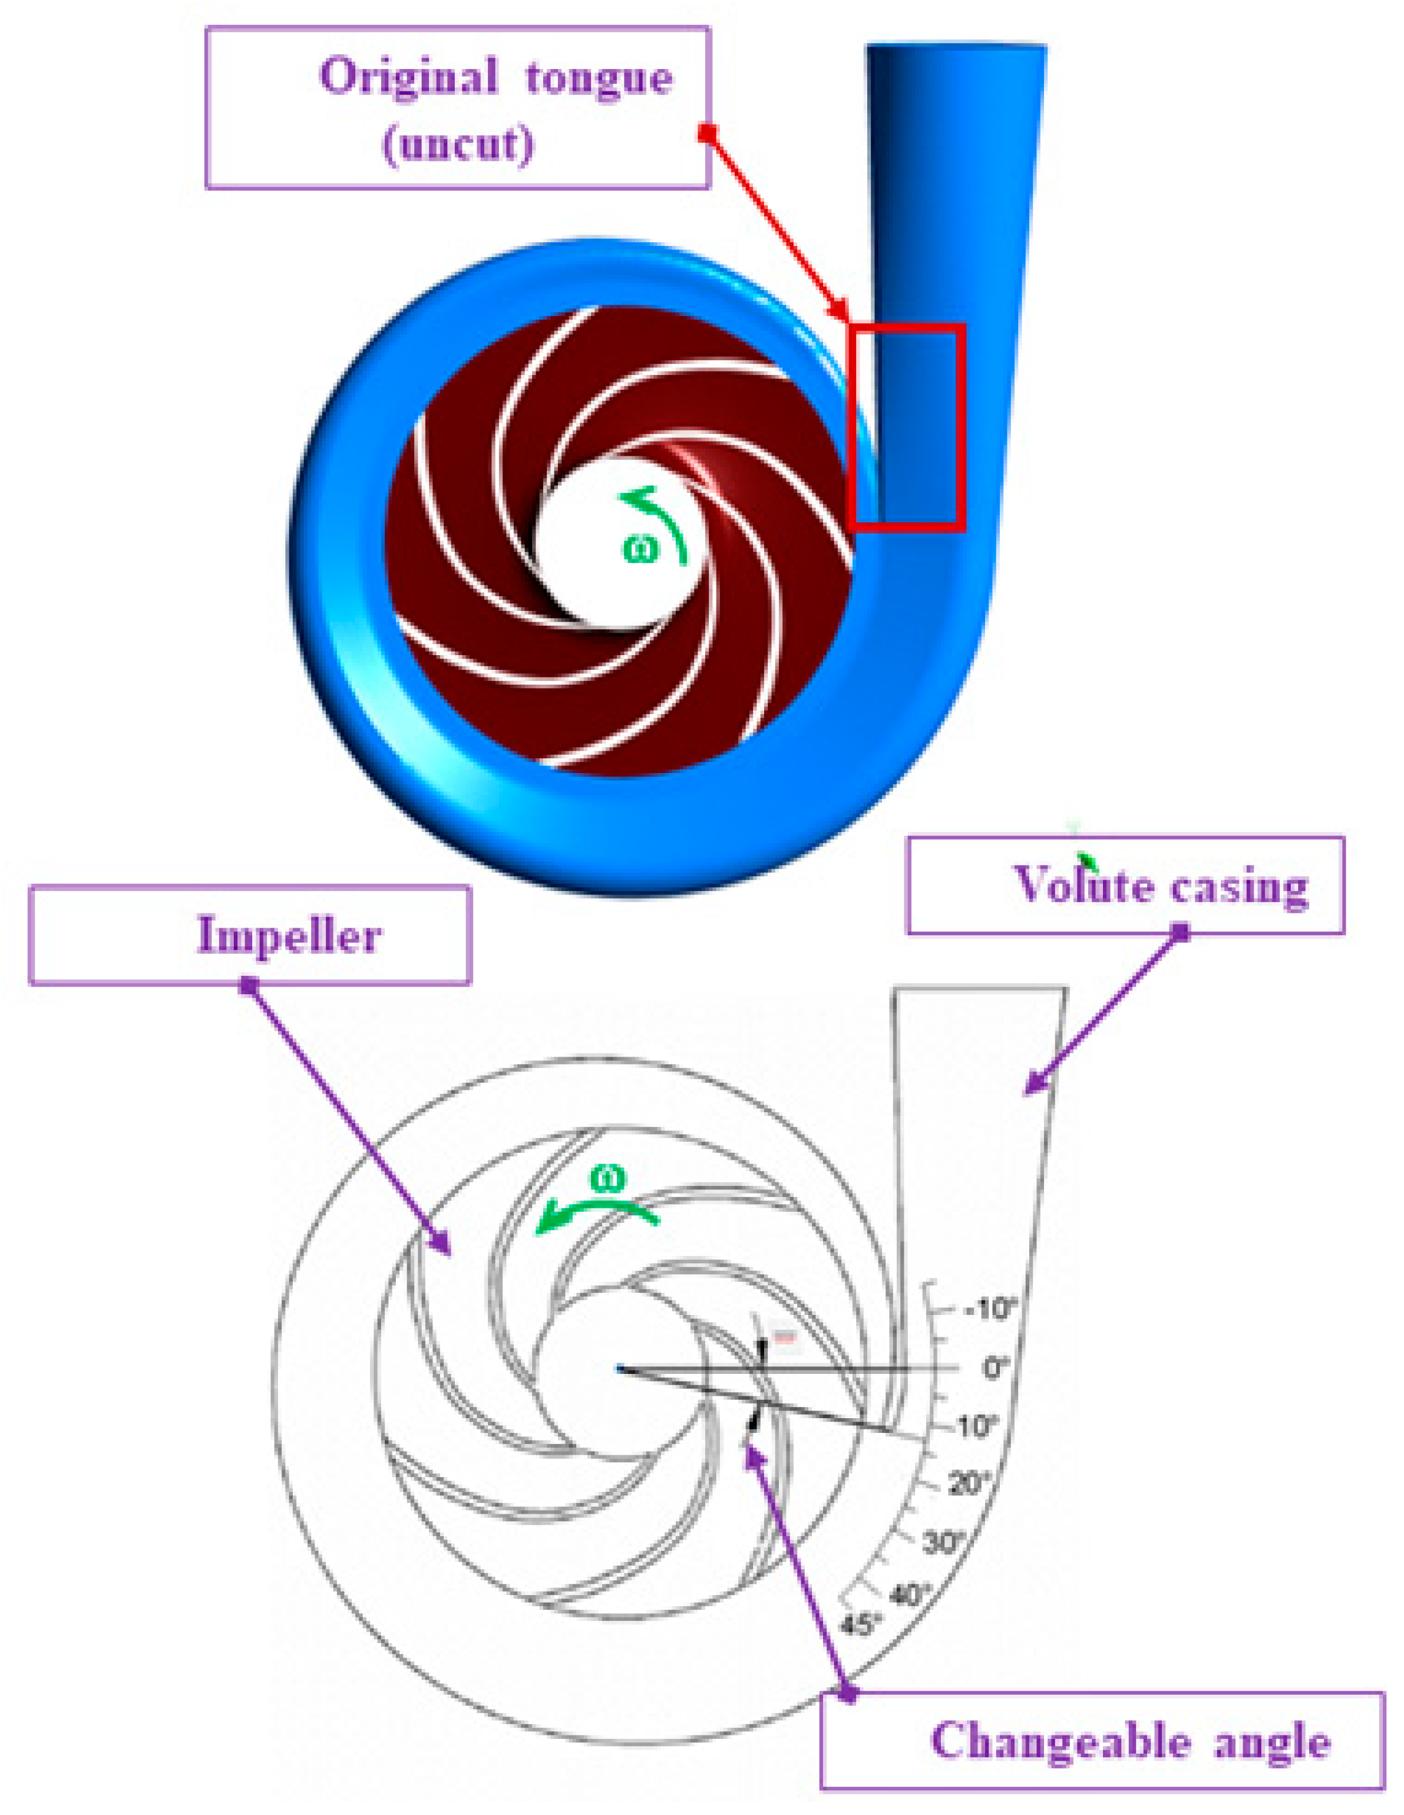
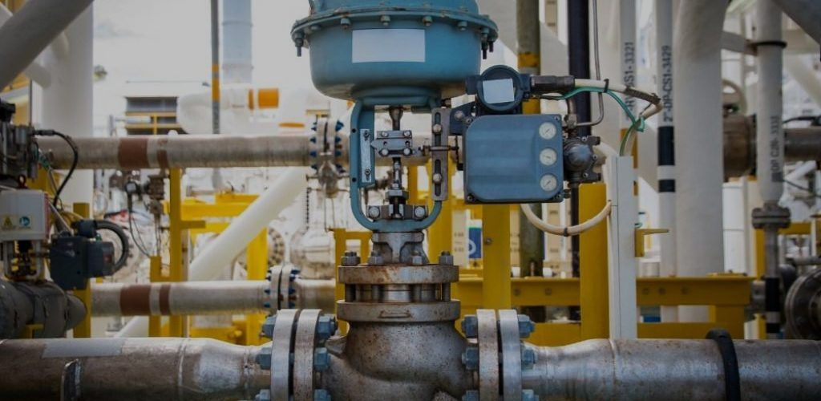
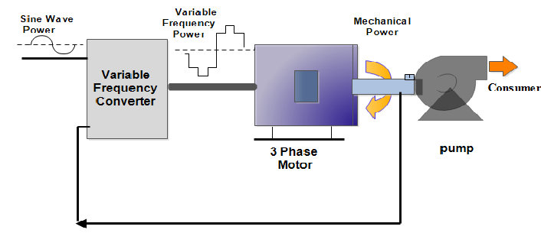
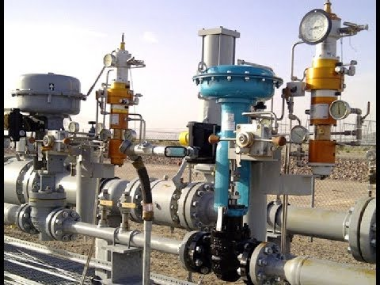
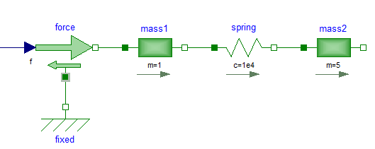
Visualizing Simulation Model Concepts
Back-pressure from Hydraulics
Dashpot

Slide 3
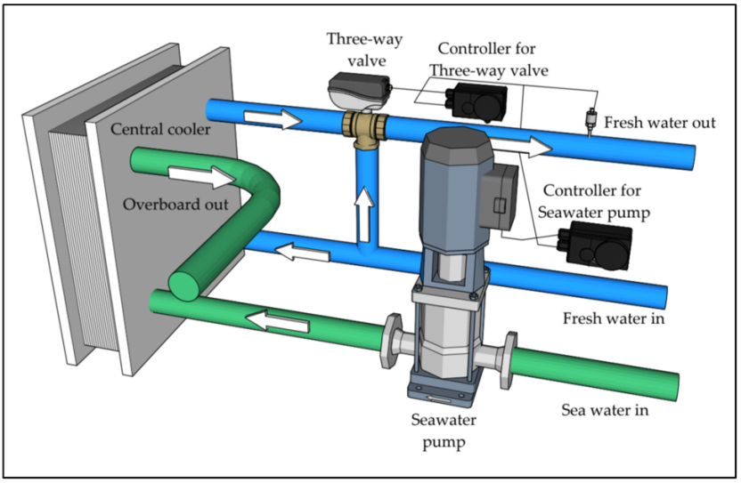
Typical Simulation Model Approach
First Order ODEs
Second Order ODEs
First Order Transfer Fn.
Second Order Transfer Fn.
Integrators
Differentiators
Transform Operators
Numerical Solvers
Controller for Three-way Valve
Controller for Sea Water Pump
Three Way Valve
Sea Water Pump
2nd order ODE
Transfer Fn.
Characteristics
Response
HEX
ODE/PDE Models
Transfer Fn. Models
Sea Water IN

Slide 4
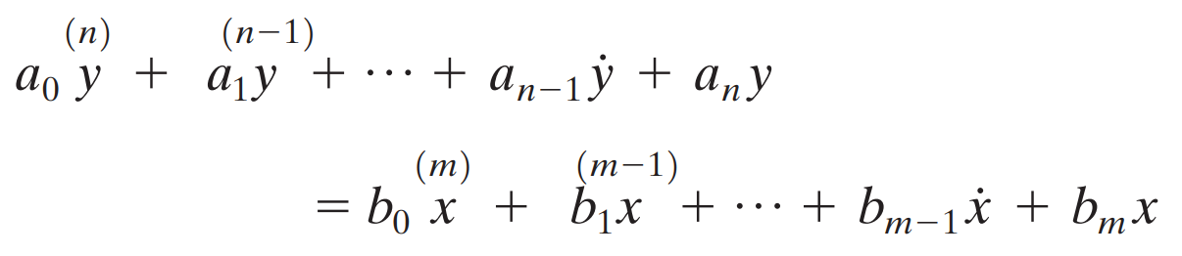
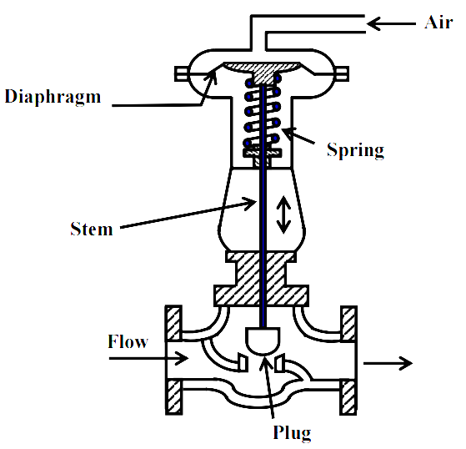
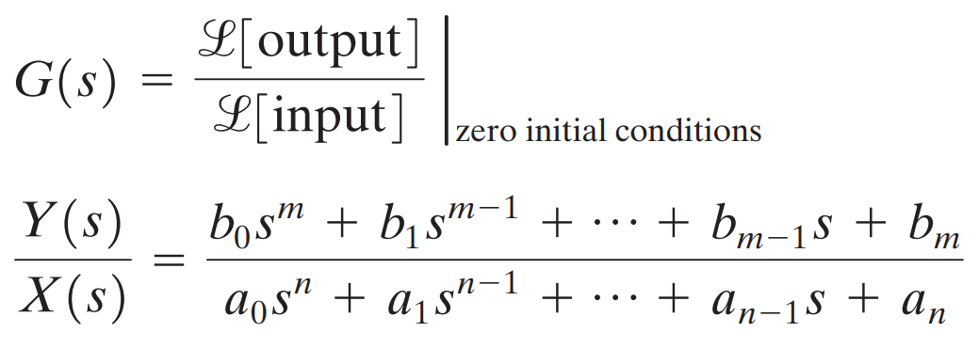
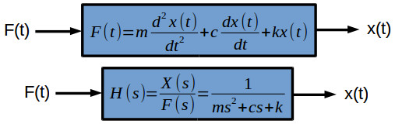
Building a Transfer Function

Slide 5
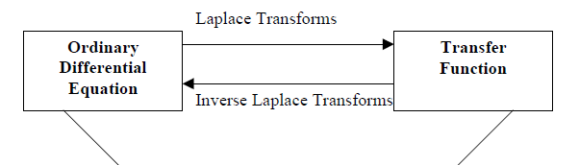
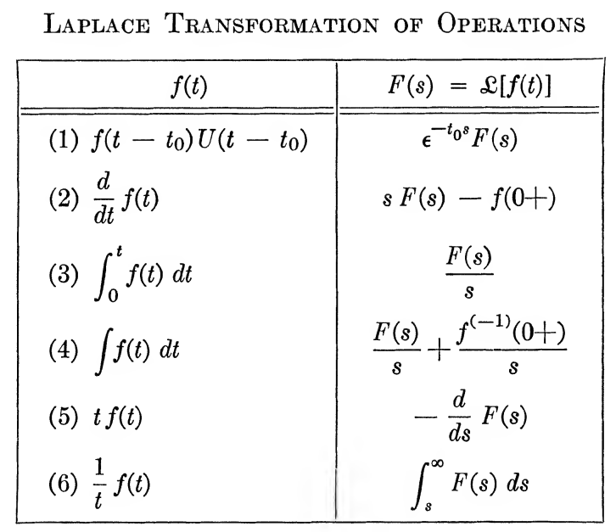
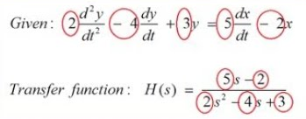
Differential Equations to Transfer Functions
Electro-Pneumatic Converter
Electrical Signal

Slide 6
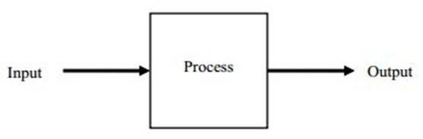
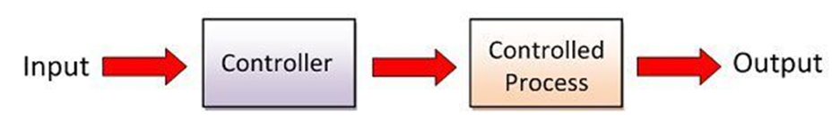
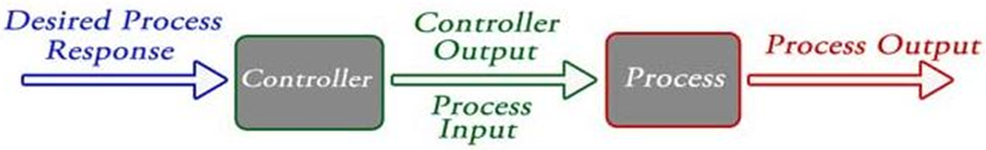
Understanding Systems as a Control Paradigm

Slide 7
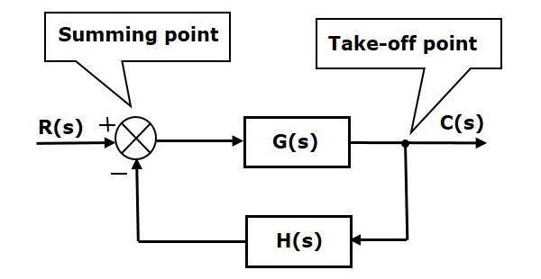
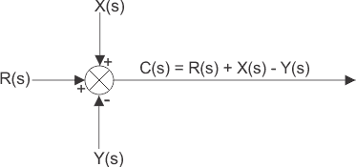
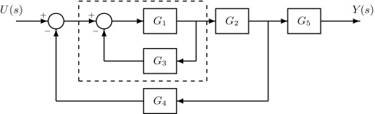
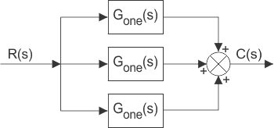
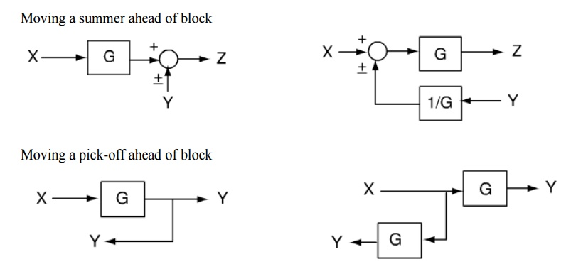
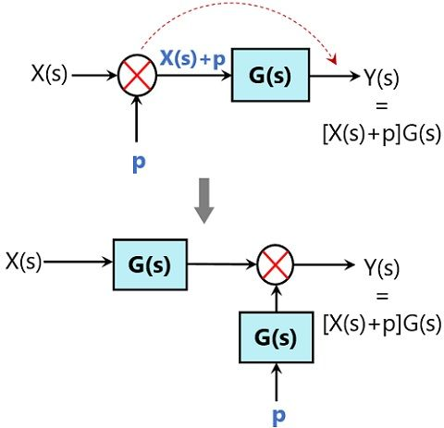
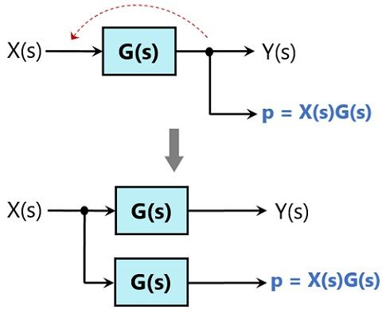
Understanding Block Diagrams

Slide 8
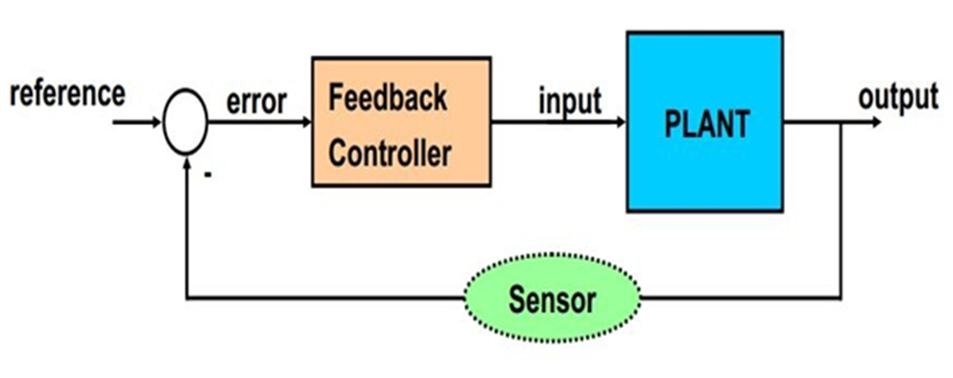
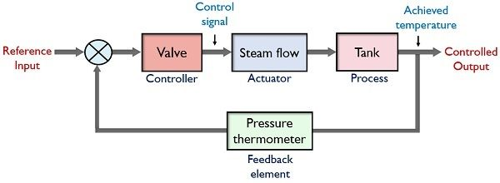
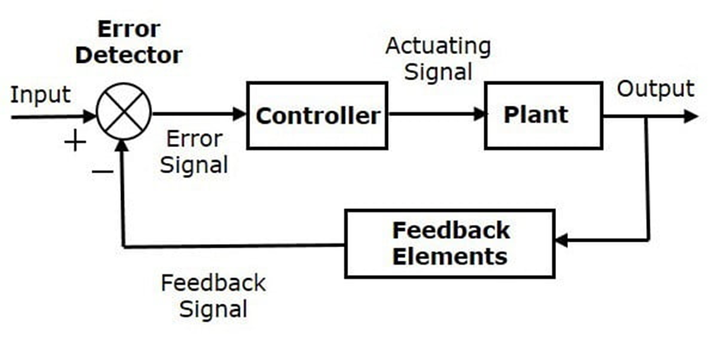
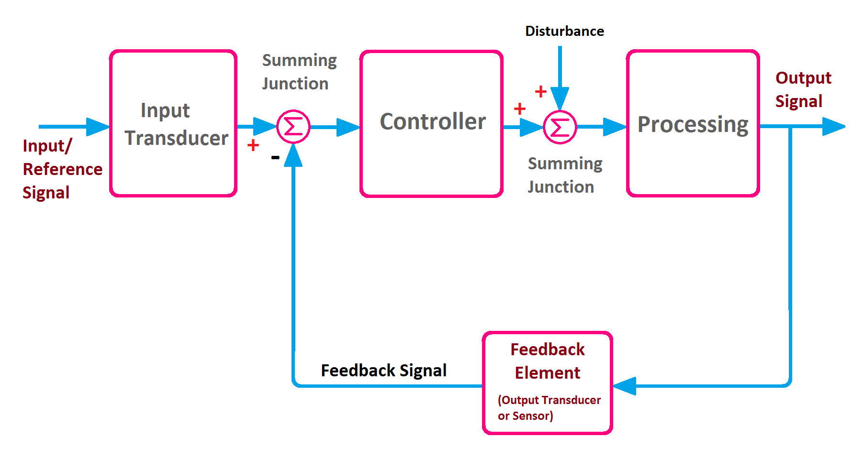
The Concept of Feedback

Slide 9
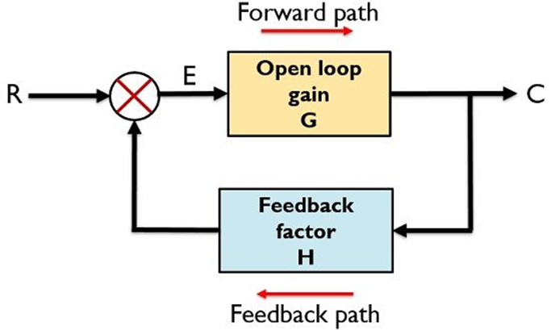
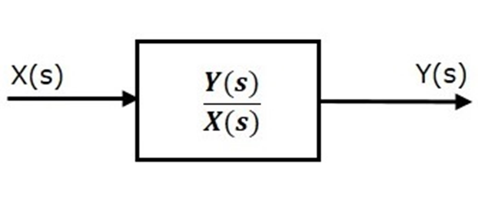
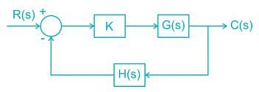
How to Analyse Feedback Loops --- The Transfer Function Approach

Slide 10
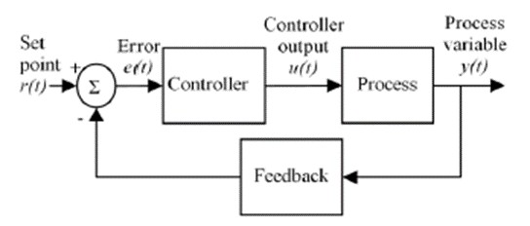
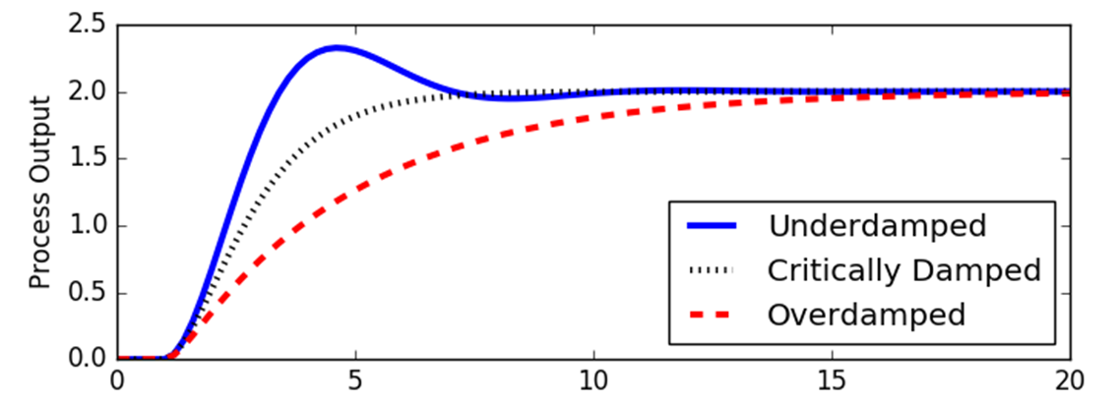
Understanding System Behaviour
Transient Characteristics
System Behaviour
Stability
Steady State
Errors
Performance Specifications

Slide 11
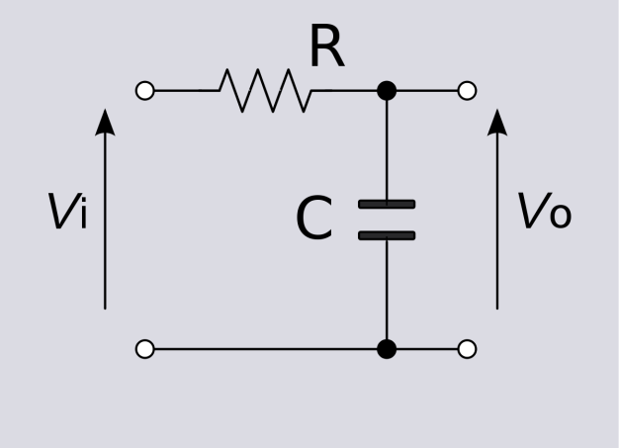
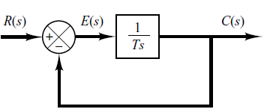
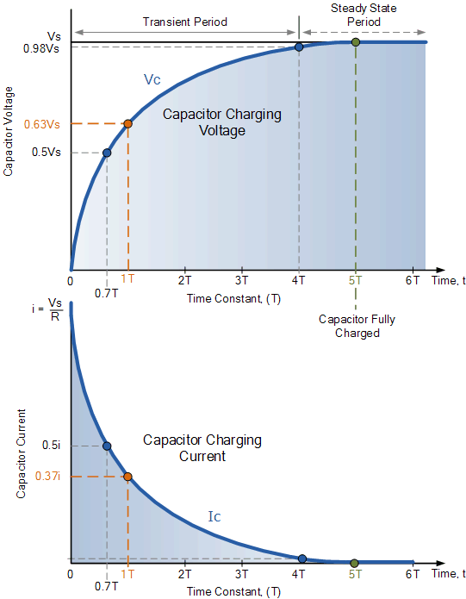
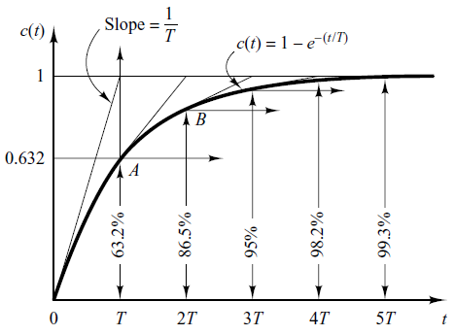
The Order of Systems

Slide 12

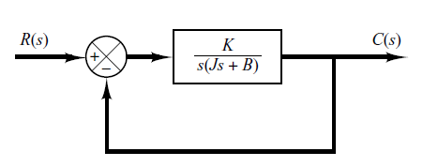
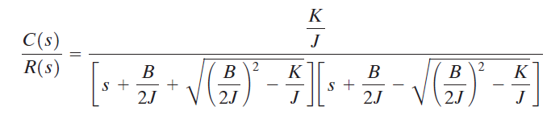

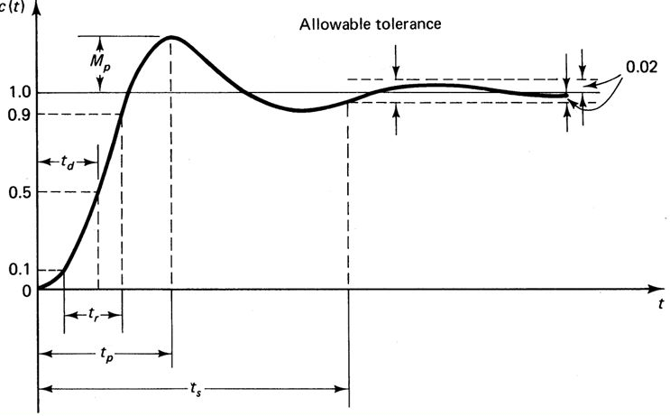


Second Order Systems

Slide 13
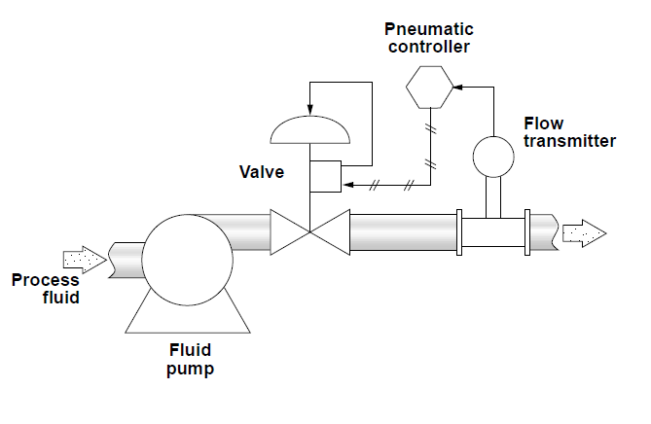
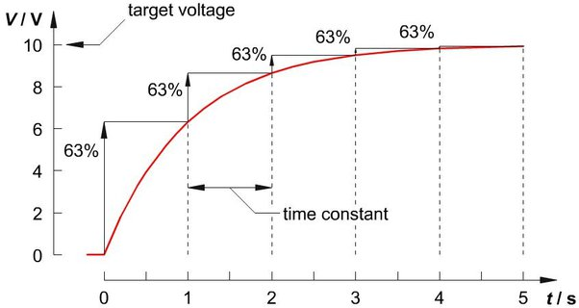
Determining Time Constants of Systems & Equipment

